Slide 1
19CSE202 DATABASE MANAGEMENT SYSTEMS 4 CREDIT COURSE

Slide 2
19CSE202 DATABASE MANAGEMENT SYSTEMS
Syllabus
Unit 1
Introduction: Overview of DBMS fundamentals – Overview of Relational Databases and Keys. Relational Data Model: Structure of relational databases – Database schema – Formal Relational Query Languages – Overview of Relational Algebra and Relational Operations. Database Design: Overview of the design process - The E-R Models –Constraints - Removing Redundant Attributes in Entity Sets - E-R Diagrams - Reduction to Relational Schemas -Entity Relationship Design Issues - Extended E-R Features – Alternative E-R Notations – Overview of Unified Modeling Language (UML).

Slide 3
19CSE202 DATABASE MANAGEMENT SYSTEMS
Unit 2
Relational Database Design: Features of Good Relational Designs - Atomic Domains and 1NF - Decomposition using
Functional Dependencies: 2NF, 3NF, BCNF and Higher Normal Forms. Functional Dependency Theory – Algorithm for Decomposition – Decomposition using multi-valued dependency: 4NF and 4NF decomposition. Database design
process and its issues. SQL: review of SQL – Intermediate SQL – Advanced SQL

Slide 4
19CSE202 DATABASE MANAGEMENT SYSTEMS
Unit 3
Transactions: Transaction concept – A simple transaction model - Storage structure - Transaction atomicity and durability - Transaction isolation – Serializability – Recoverable schedules, Casecadeless schedules. Concurrency control: Lock-based protocols – Locks, granting of locks, The two-phase locking protocol, implementation of locking, Graph-based protocols. Deadlock handling: Deadlock prevention, Deadlock detection and recovery.
Case Study: Different types of high level databases – MongoDB, Hadoop/Hbase, Redis, IBM Cloudant, DynamoDB,
Cassandra and CouchDB etc . Tips for choosing the right database for the given problem.

Slide 5
19CSE202 DATABASE MANAGEMENT SYSTEMS
File processing/traditional database applications
Student.txt with 3 records
Student.c to read and print 3 records

Slide 6
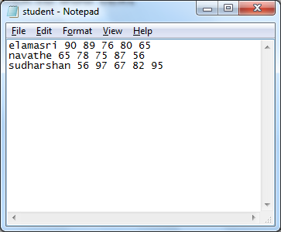
19CSE202 DATABASE MANAGEMENT SYSTEMS

Slide 7
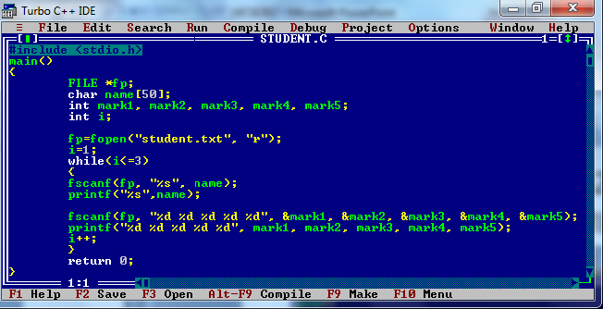
19CSE202 DATABASE MANAGEMENT SYSTEMS

Slide 8
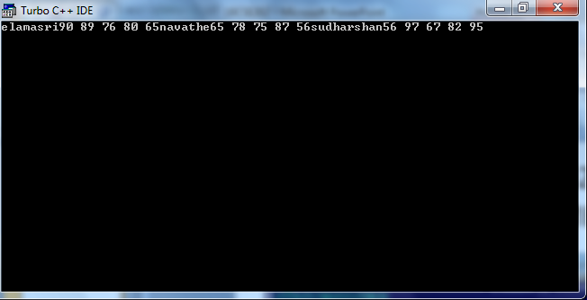
19CSE202 DATABASE MANAGEMENT SYSTEMS

Slide 9
19CSE202 DATABASE MANAGEMENT SYSTEMS
Textual and numeric data
Multimedia database-pictures, video, audio
Geographical information systems (GIS)
store and analyze maps, weather data, satellite images
Data warehouses (very large database)
online analytical processing – data mining
Example: scooty

Slide 10
19CSE202 DATABASE MANAGEMENT SYSTEMS
Real-time and active database technology
Example: Air traffic control
Search on world wide web which is a huge database
Known examples
Contacts on mobile phone
AUMS

Slide 11
19CSE202 DATABASE MANAGEMENT SYSTEMS
A database is a collection of related data
Data-known facts(student regno and marks)that can be recorded(possible to record weather forecast data) and that can have implicit meaning
The examples above is a collection of related data with an implicit meaning and hence is a database.

Slide 12
19CSE202 DATABASE MANAGEMENT SYSTEMS
student data and monthly purchase data
-not related

Slide 13
19CSE202 DATABASE MANAGEMENT SYSTEMS
Implicit properties of database
-miniworld or Universe of Discourse Example: CSE student database in All Depts databse
-inherent meaning
random assortment of data cannot be refered to a database(student, library, address combined)
-specific purpose
intended group of users and application

Slide 14
19CSE202 DATABASE MANAGEMENT SYSTEMS
Size of database
-known contacts (hundreds)
-catalog of large library (millions)
- IT forms of tax payers, weather forecast data:TB

Slide 15
19CSE202 DATABASE MANAGEMENT SYSTEMS
DATABASE MANAGEMENT SYSTEM
Collection of programs used to create and maintain a database
General purpose software system
Defines, constructs and manipulating databases

Slide 16
19CSE202 DATABASE MANAGEMENT SYSTEMS
Definition of database
Specify the data types, structures and constraints(students who have no arrears for campus interview) for data
Construction of database
- Storing the data on some storage medium
Manipulation of database
Query, retrieve, updating data and report generation

Slide 17
Database
Database
is collection of related data and its metadata organized in a structured format
for optimized information management
Database Management System (DBMS)
is a software that enables easy creation, access, and modification of databases
for efficient and effective database management
Database System ( Database + DBMS)
is an integrated system of hardware, software, people, procedures, and data
that define and regulate the collection, storage, management, and use of data within a database environment
Notes:
End user data – raw facts of interests to the end user
Metadata – description of data characteristics and relationships
Organization of data helps:
improve data accuracy
improve timely access
correlation and comparison
DBMS: a collection of programs that manages the database structure, control access to data
- Makes data management more efficient and effective
- Query language allows quick answers to ad hoc queries
- Provides better access to more and better-managed data
- Promotes integrated view of organization’s operations
- Reduces the probability of inconsistent data

Slide 18
Data vs. Information
Data:
Raw facts; building blocks of information
Unprocessed information
Information:
Data when processed .
Knowledge :
Information when processed
Intelligence :
- Knowledge when processed

Slide 19
Database Systems
A database system consists of
Data (the database)
Software
Hardware
Users
We focus mainly on the software
Database systems allow users to
Store
Update
Retrieve
Organise
Protect
their data.

Slide 20
Database Management Systems
A database is a collection of information
A database management system (DBMS) is the software than controls that information
Examples:
Oracle
DB2 (IBM)
MS SQL Server
MS Access
Ingres
PostgreSQL
MySQL

Slide 21
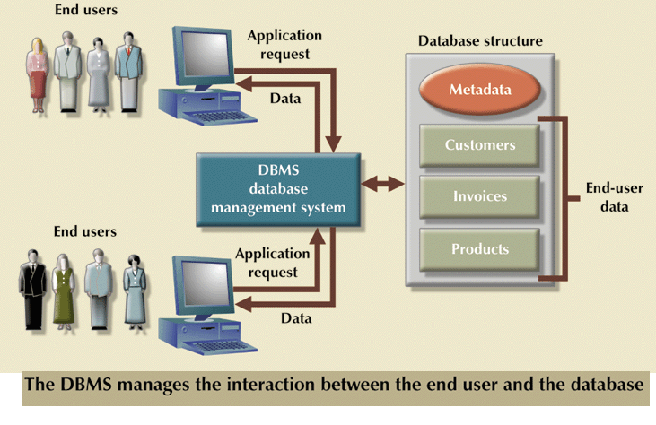
Role of DBMS

Slide 22
What the DBMS does
Provides users with
Data definition language (DDL)
Data manipulation language (DML)
Data control language (DCL)
Transaction control language (TCL)
Often these are all the same language
DBMS provides
Persistence
Concurrency
Integrity
Security
Data independence
Data Dictionary
Describes the database itself(table, views,indexes,users etc.)
Information about who is using which data (locks)
Schemas and mappings

Slide 23
19CSE202 DATABASE MANAGEMENT SYSTEMS
DATABASE + DBMS =DATABASE SYSTEM

Slide 24
19CSE202 DATABASE MANAGEMENT SYSTEMS
EXAMPLE OF A DATA BASE

Slide 25
19CSE202 DATABASE MANAGEMENT SYSTEMS
STUDENT
Name | Student Number | Class | Major
Smith | 17 | 1 | CS
Brown | 8 | 2 | CS

Slide 26
19CSE202 DATABASE MANAGEMENT SYSTEMS
COURSE
CourseName | CourseNumber | CreditHours | Department
Intro to Computer Science | CS1310 | 4 | CS
Data Structures | CS3320 | 4 | CS
Discrete Mathematics | MATH2410 | 3 | MATH
Database | CS3380 | 3 | CS

Slide 27
19CSE202 DATABASE MANAGEMENT SYSTEMS
SECTION
Section Identifier | Course Number | Semester | Year | Instructor
85 | MATH2410 | Fall | 98 | King
92 | CS1310 | Fall | 98 | Anderson
102 | CS3320 | Spring | 99 | Knuth
112 | MATH2410 | Fall | 99 | Chang
119 | CS1310 | Fall | 99 | Anderson
135 | CS3380 | Fall | 99 | Stone

Slide 28
19CSE202 DATABASE MANAGEMENT SYSTEMS
GRADE_REPORT
StudentNumber | SectionIdentifier | Grade
17 | 112 | B
17 | 119 | C
8 | 85 | A
8 | 92 | A
8 | 102 | B
8 | 135 | A

Slide 29
19CSE202 DATABASE MANAGEMENT SYSTEMS
PREREQUISITE
CourseNumber | PrerequisiteNumber
CS3380 | CS3320
CS3380 | MATH2410
CS3320 | CS1310

Slide 30
19CSE202 DATABASE MANAGEMENT SYSTEMS
SIMPLIFIED DATABASE SYSTEM ENVIRONMENT

Slide 31
Users/ Programmers
DATABASE
SYSTEM
Application Programs/Queries
DBMS S/W
Software to process Queries/Programs
Software to Access Stored Data
Stored database definition
(Metadata)
Stored
Database

Slide 32
19CSE202 DATABASE MANAGEMENT SYSTEMS
Smith in STUDENT record with StudentNumber 17, related to GRADE_REPORT with StudentNumber 17-reveals grade in two sections

Slide 33
File Based Systems
File based systems
Data is stored in files (collection of records)
Record (Collection of fields)
Each file has a specific format
File Organization
Sequential
Pointer
Indexed
Direct
Problems or Issues :
No standards
Data Redundancy
Data dependence
Data Inconsistency
No way to generate ad hoc queries
No provision for security, recovery, concurrency, etc.
Atomicity Problems

Slide 34
Purpose of DBMS
Data Independence and efficient access.
Data Integrity , Data Security , Data Consistency
Data Sharing
Reduced Data Redundancy
Uniform data administration.
Concurrent access.
Recovery from crashes.
Provides Multiple User Interface.
Represent Complex relationship among data
Reduced application development time.
Notes:
3

